Slide 1

Marketing Your ChiRunning® Business
Instructor Marketing Support
Notes:
You want to build your business as a Chirunning Instructor or Regional Director. How do you find new ChiRunners? The internet has changed the consumer – your business must step up to the changes.

Slide 2

Instructor Marketing Support
You Are Branded
Notes:
Your business advantage – already branded

Slide 3
Remember
Brand
is an evolving asset.
requires continued attention.
your customers will have a big role in shaping.
you’ll need to foster.
make adjustments to as your business grows or changes.
Always Include
your brand
your name
your primary contact “website”
In EVERYTHING you do.
Printed
Web
Social
Content
Promo
Graphics
Notes:
Branding is Basic Exposure.
Everything you do should visibly show your most important information – name and website.
All efforts drive to one place – your website.

Slide 4
Who Are You
BRAND
PERSONA
What Do You Do
Where Can I Find You
Notes:
BEFORE you can market who you are and what you do.
Create your IIDP – you in the digital world.

Slide 5
You 3D
Persona
Logo
Color Style Sheet
Tagline
Vision Statement
Become
Mission Statement
Purpose
USP
Competitive Edge
Essence
Emotions of Experience
Personality
Human Characteristics
Position of Value
Benefit of the Brand
Writing
Audio
Content
Images
Instructional
Informative
Visual
Audible
Emotional
Intellectual
Notes:
Create Your online presence- HOW?
Even if you are an established successful business – you will loose your foothold in your market if you do not establish who you are on the internet.
Once defined, you expose it as your basic foundation that you broadcast in every effort.
Strong foundation validates your efforts.

Slide 6

The Marketing Wheel
Engaging the Gears
Blogging
Social Media Footprint
Email Marketing
Website/ StoreFront
Ads
ECommerce
Public Relations
Analysis
Has No Beginning
Has No End
Notes:
Marketing includes all efforts of exposure and engagement to gain one result. $$
Every gear has to turn.

Slide 7
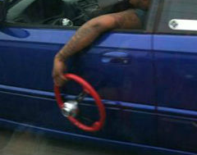
The Marketing Wheel
Must Be Driven
Blogging
Social Media Footprint
Email Marketing
Website/ StoreFront
Ads
ECommerce
Public Relations
Analysis
Notes:
When marketing stops – exposure stops
Exposure stops – revenue diminishes. It must be driven

Slide 8
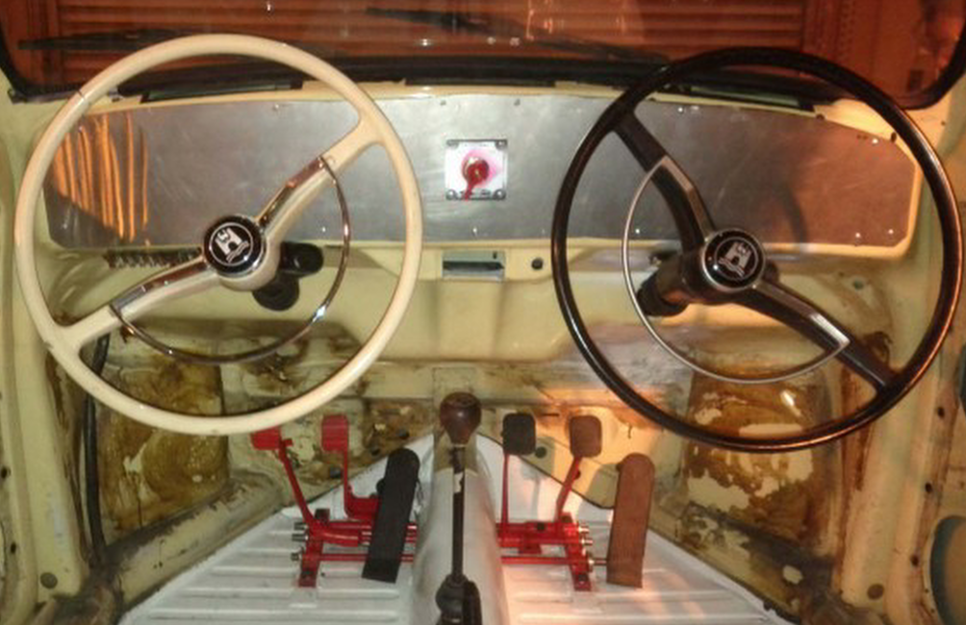
The Marketing Wheel
Who’s Driving?
Blogging
Social Media Footprint
Email Marketing
Website/ StoreFront
Ads
ECommerce
Public Relations
Analysis
WHO’S DRIVING?
Notes:
Who’s Driving? Good question.

Slide 9

The Marketing Wheel
WHO’S DRIVING?
With Input, and Consult from a Team Specialists
Blogging
Social Media Footprint
Email Marketing
Website/ StoreFront
Ads
ECommerce
Public Relations
Analysis
MANY RESOURCES
Notes:
Input from many sources within your company.
You may have a team with a marketing manager or director, it may be just you with consultants.
Use the Input. Allow all gears to support each other – They will each drive an area.

Slide 10

The Marketing Wheel
YOU
Steer the Direction
Blogging
Social Media Footprint
Email Marketing
Website/ StoreFront
Ads
ECommerce
Public Relations
Analysis
Notes:
Ultimately, valuable information is gathered and You have to steer the direction.

Slide 11
The Marketing Wheel
What is?
Blogging
Social Media Footprint
Email Marketing
Website/ StoreFront
Ads
ECommerce
Public Relations
Analysis
SEO
Notes:
Like cogs/gears.
Internal gears – all efforts are empty if SEO isn’t met.
In the digital world of the internet – results happen by one vehicle. SEO – what is?

Slide 12
The Marketing Wheel
SEO Always Turning
Blogging
Social Media Footprint
Email Marketing
Website/ StoreFront
Ads
ECommerce
Public Relations
Analysis
SEO
Site Structure
Each Component
Notes:
Search engines read every piece of information online.
How it treats that information results in your availability online.

Slide 13
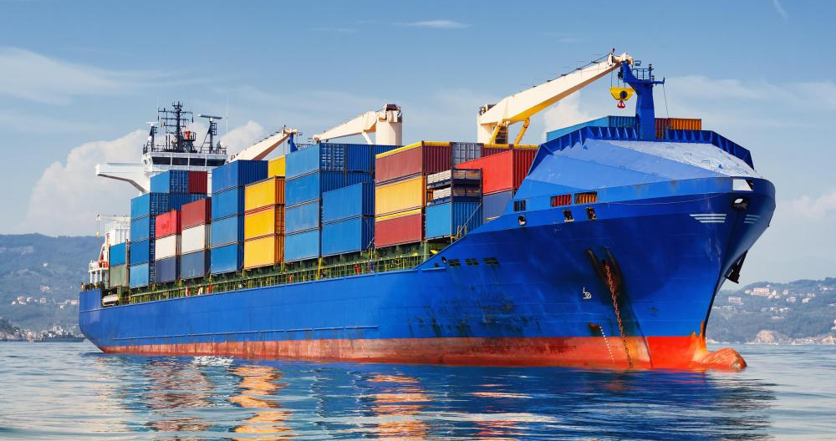
The Marketing Wheel
SEO Carries You to Your Consumer
Blogging
Social Media Footprint
Email Marketing
Website/ StoreFront
Ads
ECommerce
Public Relations
Analysis
SEO
ALL Efforts
Internal Website
Notes:
It’s like a cargo carrier – the SEO of every move you make on the internet determines how and if people find you.
Your current consumers know who you are and will always be able to find you online.
BUT how does your next consumer fiind you?
Word of mouth – always good –
Sharing a cool post from facebook – another great way.
But what about the people who have never heard of you or ChiRunning?
They find you on the internet by doing a search – for Chirunning? Not likely, it’s those other important words.
That’s where we drive all the vehicles to the cargo carrier so it can be delivered in front of your next consumer. Gears turn the Wheel.

Slide 14

The Marketing Wheel
Where does it Turn
Blogging
Social Media Footprint
Email Marketing
Website/ StoreFront
Ads
ECommerce
Public Relations
Analysis
SEO
Notes:
Through all these places. IF the search engines like what they see.

Slide 15
The Marketing Wheel
And It Has Rules
Blogging
Social Media Footprint
Email Marketing
Website/ StoreFront
Ads
ECommerce
Public Relations
Analysis
CONTENT AND COPY
Headlines and Tags
Images
SEO Style
Keywords and Meta
Notes:
Search Engines read coded text.
Every effort includes Content and Copy

Slide 16

The Marketing Wheel
SEO Turns and Burns
Blogging
Social Media Footprint
Email Marketing
Website/ StoreFront
Ads
ECommerce
Public Relations
Analysis
SEO
Too many Keywords
Duplication
Bad META
Improper Tags
Notes:
SEO Turns and Burns – Best Practices Make it Turn – Non-compliancy Burns

Slide 17

The Marketing Wheel
HOW WHY
Blogging
Social Media Footprint
Email Marketing
Website/ StoreFront
Ads
ECommerce
Public Relations
Analysis
SEO
Too many Keywords
Duplication
Bad META
Improper Tags
Notes:
Webcrawling - the Internet Police – Keep it Safe with Good Information

Slide 18
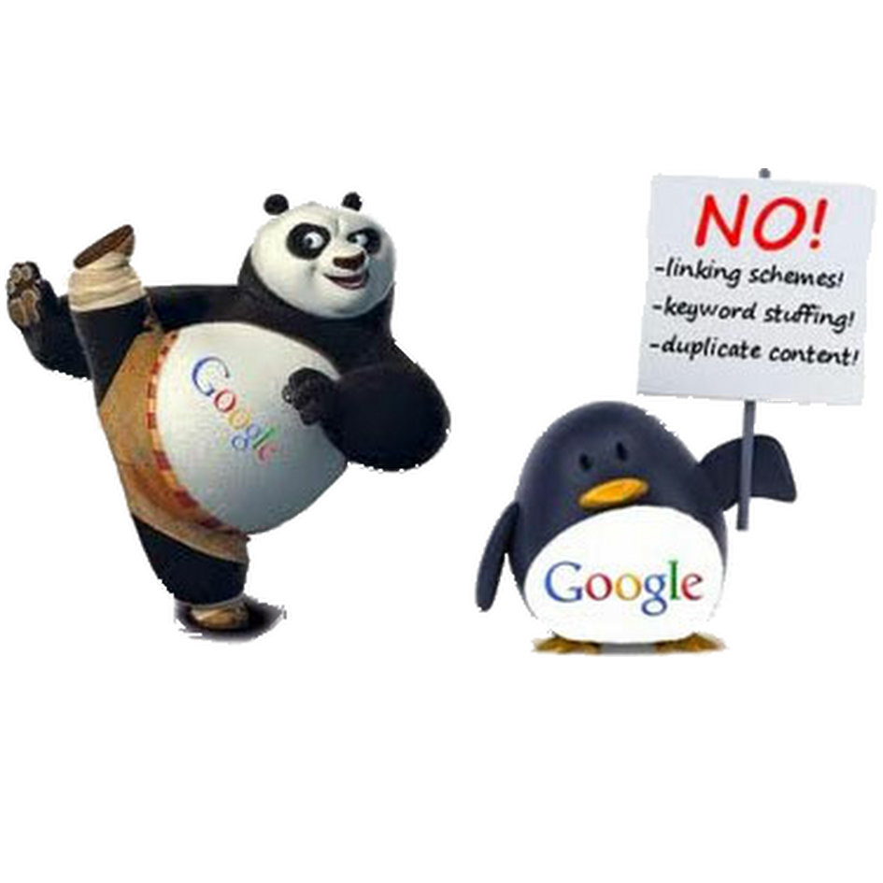
The Marketing Wheel
WHO’S DRIVING?
Result of Bad SEO
Blogging
Social Media Footprint
Email Marketing
Website/ StoreFront
Ads
ECommerce
Public Relations
Analysis
SEO
Cannot Find
Filtered
TIME
Sanctioned
Notes:
Bad SEO results in being Filtered or even Sanctioned – Compliancy isn’t an option.

Slide 19

The Marketing Wheel
WHO’S DRIVING?
These Guys
Ain’t Kiddin’
Blogging
Social Media Footprint
Email Marketing
Website/ StoreFront
Ads
ECommerce
Public Relations
Analysis
Notes:
Current panda Roll Out is slow –
No announcement for you – results indicate.

Slide 20

The Marketing Wheel
WHO’S DRIVING?
No Exceptions No Forgiveness
Blogging
Social Media Footprint
Email Marketing
Website/ StoreFront
Ads
ECommerce
Public Relations
Analysis
Notes:
No longer can we pick up the phone and coherse or sweet talk our desired result.
More and more internet companies and apps – prominent and specific – have no phone support.
Support is email based, and can involve a long thread if you cannot properly explain your issue.

Slide 21
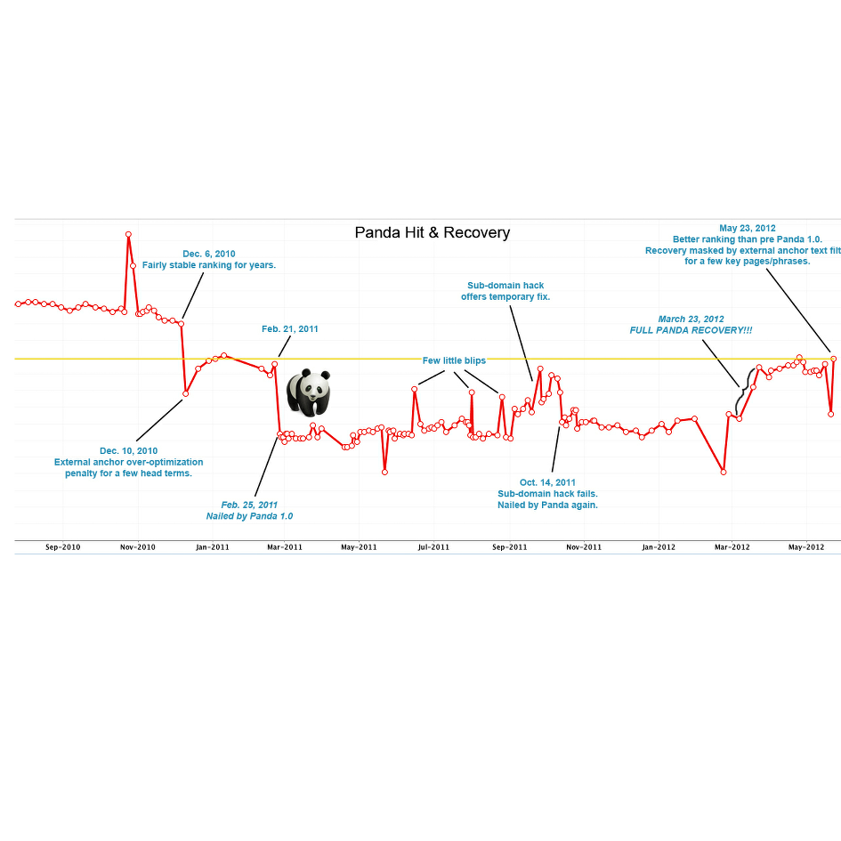
The Marketing Wheel
Example of being Panda’d
Notes:
First rollout 2011 – they are announced – updates are difficult – know by your metrics

Slide 22
The Marketing Wheel
SEO is Vital
Blogging
Social Media Footprint
Email Marketing
Website/ StoreFront
Ads
ECommerce
Public Relations
Analysis
Good SEO Bad
Consequence
Real
Notes:
If you didn’t think it was important before – Hopefully You do now.

Slide 23
The Marketing Wheel
HOW Does it Turn
Blogging
Social Media Footprint
Email Marketing
Website/ StoreFront
Ads
ECommerce
Public Relations
Analysis
SEO
COPY
CONTENT
Notes:
Let’s go back to our wheel- Internal gears Engaged by Content and Copy – A difference you can feel.

Slide 24
The Marketing Wheel
What YOU Can Do
Blogging
Social Media Footprint
Email Marketing
Website/ StoreFront
Ads
ECommerce
Public Relations
Analysis
CONTENT AND COPY
Headlines
Images
SEO Style
Keywords
Copy Sells
Content Tells
Notes:
Every effort includes Content and Copy

Slide 25
The Marketing Wheel
Blogging
Social Media Footprint
Email Marketing
Website/ StoreFront
Ads
ECommerce
Public Relations
Analysis
Yes, “content tells” (a brand’s story, a brand’s heart) rather than “sells.”
DO NOT make the mistake of stuffing content with copy!
Notes:
Outdated styles are no longer effective.

Slide 26
The Marketing Wheel
WHEN DO THEY SHARE
Landing Pages
Email Marketing Ecommerce Promotions
CONTENT TELLS
Blog Posts
Social Media
Brand Narratives
Press/Media
Newsletters
Surprising/Unconventional
All about your prospects
Genuine, Empathetic Dialogue
Sharing Perspectives
Engaging Communities
Encourage Discussion/Debate
COPY
SELLS
Static Brochures
Printed Advertising
Ads
Headlines/Subject Lines Splash Pages
Safe/Familiar
All about you
Lofty in tone
One-way communication
Straightforward information
People return to good Content.
Gets you to the Website.
Notes:
Very distinctive purposes. Your presence needs them both. For an effective result, it’s important to use them correctly.

Slide 27
The Marketing Wheel
Basic SEO Format
Blogging
Social Media Footprint
Email Marketing
Website/ StoreFront
Ads
ECommerce
Public Relations
Analysis
ORIGINAL
CONTENT AND COPY
Titles and Tags
Keywords
Linkage
META
Notes:
Only Use an H1 Title and H1 tag per page. (Unseen) Use proper hierarchy in page – H1 and H2 – never skip to H3 – simply bold.
Meta doesn’t help rank, but it’s incredibly important in search engine marketing
At no time on the website will any two titles include the same keyword in another title tag or heading.
One keyword for a website page – blogs and copy can carry 2-3- no longer read but important as support tool
Keyword tags are not looked at anymore by search engines and are primarily used for human benefit in the search – use 1

Slide 28
The Marketing Wheel
Relevant and Valuable
Blogging
Social Media Footprint
Email Marketing
Website/ StoreFront
Ads
ECommerce
Public Relations
Analysis
CONTENT
Word Choices
Audience
Link Building
Headlines
Purpose
Word Strategy
Exclusivity
Empathy
Social Proof
Personal
Warm Invites
Include Downloads
Tell Them
Subject Lines
Buttons
Overwhelming Value
Leverage Brand - Scarcity
Social Trends – Current Events
Thanks
Annouce
Notes:
The fact is, content writing has less to do with broadcasting self-perceived greatness than with meeting audiences on their turf and engaging them in an open, honest, two-way dialogue about what matters to them.

Slide 29
The Marketing Wheel
Make it SEO
Blogging
Social Media Footprint
Email Marketing
Website/ StoreFront
Ads
ECommerce
Public Relations
Analysis
COPY
Word Choices
Audience
Tell Them
Headlines
Products and Services
5 MOST INFLUENTIAL WORDS IN ENGLISH LANGUAGE
You
Free
Because
Instantly
New
Notes:
Straightforward overview, smartly worded with good flow and a professional tone. Mission – offerings – punctuation – testimonials - pizzazz – photos
5 most influential words in the english language.

Slide 30
The Marketing Wheel
Use the Search Engine
Blogging
Social Media Footprint
Email Marketing
Website/ StoreFront
Ads
ECommerce
Public Relations
Analysis
BLOG
Image
RE-BLOG
Links
Content Format
Notes:
CONTENT – INFORMATION - Use Blogs with all the tools the search engines provide. Proper tags/labels.
Summary – Search description in each blog.
Meta in main blog profile.

Slide 31
The Marketing Wheel
Images are EMPTY to SEO
Blogging
Social Media Footprint
Email Marketing
Website/ StoreFront
Ads
ECommerce
Public Relations
Analysis
IMAGES
Link
Summary
Alt Tags
Title
Notes:
Search Engines cannot read images – we have to create their content.

Slide 32
The Marketing Wheel
Means to an End
Blogging
Social Media Footprint
Email Marketing
Website/ StoreFront
Ads
ECommerce
Public Relations
Analysis
Email Marketing
Audience
Create Value
Subject Lines
InfoGraphics
Social Proof
Scarcity
Exclusivity
Tell Them.
Notes:
Email Marketing is alive and well.
Effectiveness – combines both content and copy
Talk to them like they are sitting beside you at the kitchen table about the things they care about.

Slide 33
The Marketing Wheel
Social Media Footprint
Blogging
Social Media Footprint
Email Marketing
Website/ StoreFront
Ads
ECommerce
Public Relations
Analysis
Image Content
Social Media
Product
Valuable Content
Webinars Video Chats
Engagement
Videos
Podcasts
Notes:
Broadcast across all strong social media. How to create effective Social Content.

Slide 34
The Marketing Wheel
Social Media WHO Is?
Blogging
Social Media Footprint
Email Marketing
Website/ StoreFront
Ads
ECommerce
Public Relations
Analysis
Google+
SEO
YouTube
Notes:
Search engines read their own first.

Slide 35
The Marketing Wheel
Social for Business Co-Efforts
Blogging
Social Media Footprint
Email Marketing
Website/ StoreFront
Ads
ECommerce
Public Relations
Analysis
Twitter
B2B
Quora
Notes:
Talk to your business partners, competitors, complimentary industries,
Co-marketing efforts

Slide 36
The Marketing Wheel
Create Your Consumer/ Community
Blogging
Social Media Footprint
Email Marketing
Website/ StoreFront
Ads
ECommerce
Public Relations
Analysis
Facebook
B2C
Pinterest
Notes:
Engagement

Slide 37
The Marketing Wheel
NO TIME to Post
Blogging
Social Media Footprint
Email Marketing
Website/ StoreFront
Ads
ECommerce
Public Relations
Analysis
Hootsuite Buffer
Social Broadcasters
Webinars Podcasts
Video Chats
Notes:
Broadcast across all strong social media.

Slide 38
The Marketing Wheel
Apps Make It Easy
Blogging
Social Media Footprint
Email Marketing
Website/ StoreFront
Ads
ECommerce
Public Relations
Analysis
Pinterest/Tailwind
Instagram /Flickr Galleries
Get the APPs
Blogger/WP
Re-posts
Notes:
Many apps make it easy to post.

Slide 39
The Marketing Wheel
Analyze the Engagement and Adapt
Blogging
Social Media Footprint
Email Marketing
Website/ StoreFront
Ads
ECommerce
Public Relations
Analysis
ENGAGEMENT
METRICS
ANALYSIS
CONVERSION
Notes:
Every Effort is Measured – Analyze to measure engagement – Adapt to Accomplish it - Reach Desired End Result -

Slide 40


The Marketing Wheel
GROW Your Business
Blogging
Social Media Footprint
Email Marketing
Website/ StoreFront
Ads
ECommerce
Public Relations
Analysis
Notes:
The internet has spoiled us to become hungry for instant gratification.
Now it is teaching us the element of time.
Creating your presence takes time.
If not continually driven, you will lose your foothold in your market.
Let’s start growing your ChiRunning Business..
JANUARY 2016 We have a Marketing Support S

Slide 41

INSTRUCTOR MARKETING SUPPORT
New Branded Business Cards
Just for YOU
Notes:
The internet has spoiled us to become hungry for instant gratification.
Now it is teaching us the element of time.
Creating your presence takes time.
If not continually driven, you will lose your foothold in your market.
Let’s start growing your ChiRunning Business..
JANUARY 2016 We have a Marketing Support Pack

Slide 42

INSTRUCTOR MARKETING SUPPORT
New Branded Business Cards

Slide 43

INSTRUCTOR MARKETING SUPPORT
Double Sided Rack Cards

Slide 44

INSTRUCTOR MARKETING SUPPORT
Double Sided Rack Cards
Available JAN 2016

Slide 45

INSTRUCTOR MARKETING SUPPORT
GIVE AWAY
Outdoor Vinyl Banner

Slide 46

The Marketing Wheel
Blogging
Social Media Footprint
Email Marketing
Website/ StoreFront
Ads
ECommerce
Public Relations
Analysis

Slide 47

The Marketing Wheel

